Slide 1

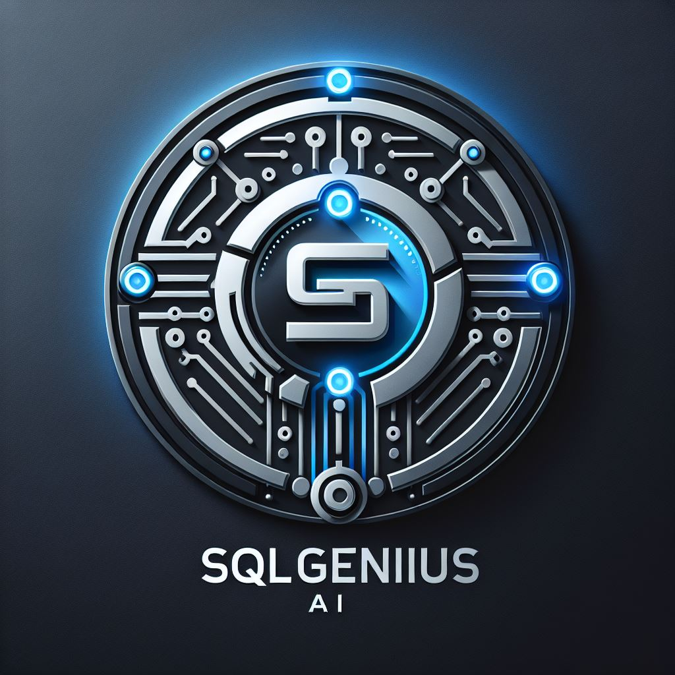
H2F_C2S_The_Quantum_Coders_Natural language to SQL query generator for non-technical users
SQLGenius: Your Intelligent SQL Assistant

Slide 2
Team & Challenge Statement Details
Team Name – THE QUANTUM CODERS
Team SPOC –
Dheeraj Khobragade-10719080(Lead)
Rahul Bhave-10714863,
Vaidehi Choudhari-10743299,
Ayush Awari-10709598,
Premachand kar-10718920
Chosen challenge statement –
Natural language to SQL query generator for non-technical users

Slide 3
Detailed Technical approach
Problem Statement:
Non-technical businesses face challenges in accessing and analyzing critical data due to a lack of SQL knowledge, leading to dependencies on technical teams and bot
Solution:
SQLGenius:
The potential solution for this problem using SQLGenius utility is as follows-
User will connect to database.
Schema will be extracted from database.
3. AI Agent will read the requirements and convert these requirements into SQL query.
4. AI Agent will run the query.

Slide 4
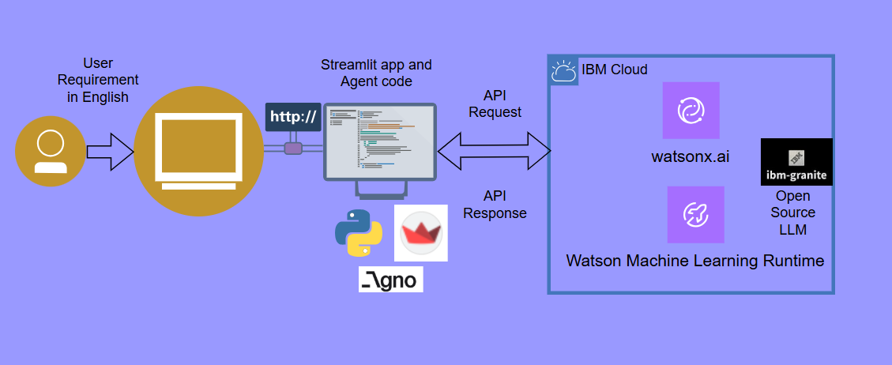
Technical Architecture:
LLM: IBM watsonx.ai platform with Granite3-8b instruct mode
Frameworks: Agno agent framework for task management
UI Framework: Streamlit for building the user interface
Database Connectivity: Support for MySQL and PostgreSQL databases
APIs: Integration APIs for connecting with other applications and services

Slide 5
Requirements - tools & software's
LLMs: IBM watsonx.ai platform with Granite3-8b instruct opensource model
Frameworks: Agno agent framework for task management
UI Framework: Streamlit for building the user interface
Database Connectivity: Support for MySQL and PostgreSQL databases
APIs: Integration APIs for connecting with other applications and services(watsonx AI ML runtime services will be connected via API key.

Slide 6
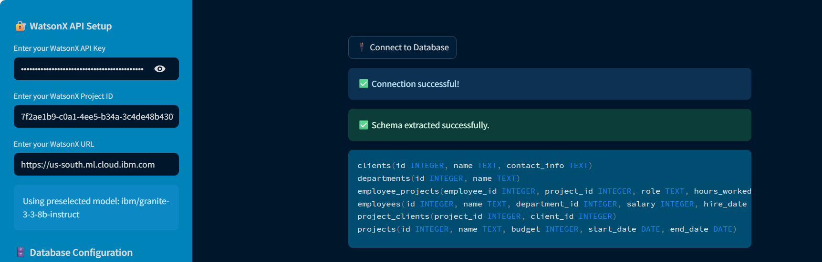
MVP 1 - Database Connectivity

Slide 7
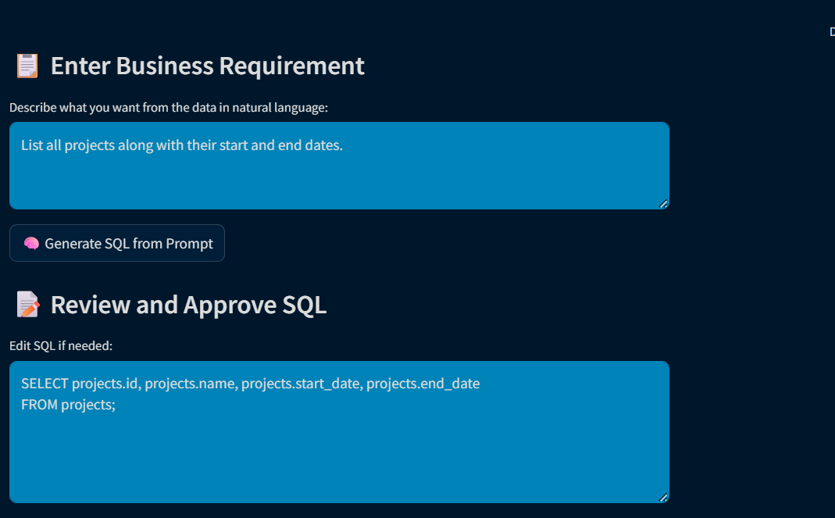
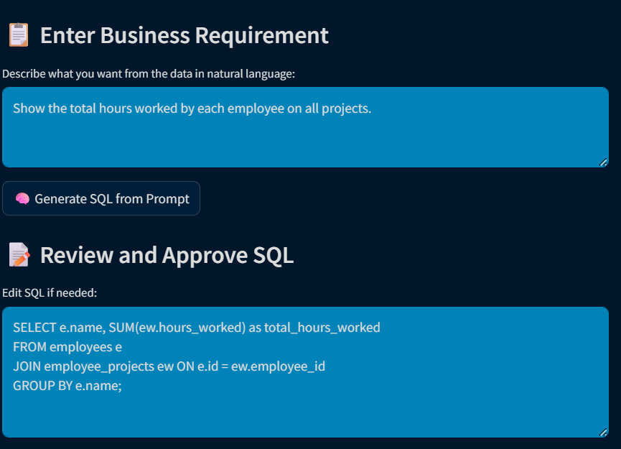
MVP 2 - NLP Processing Text to SQL
*

Slide 8
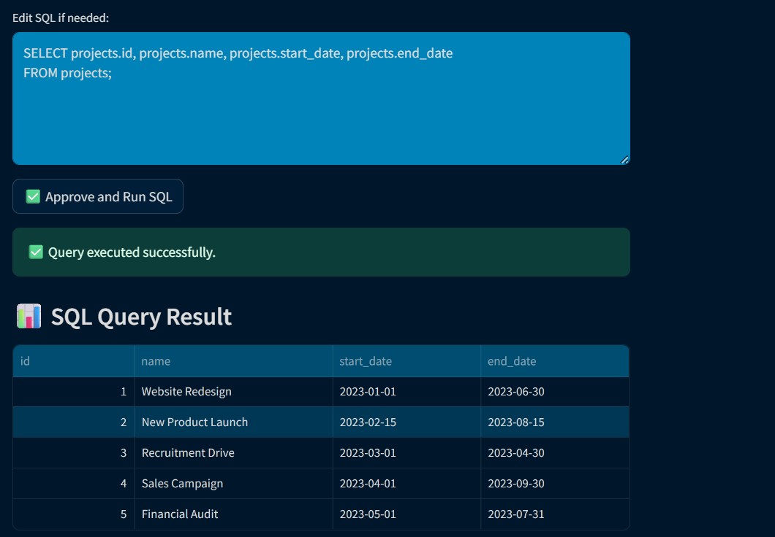
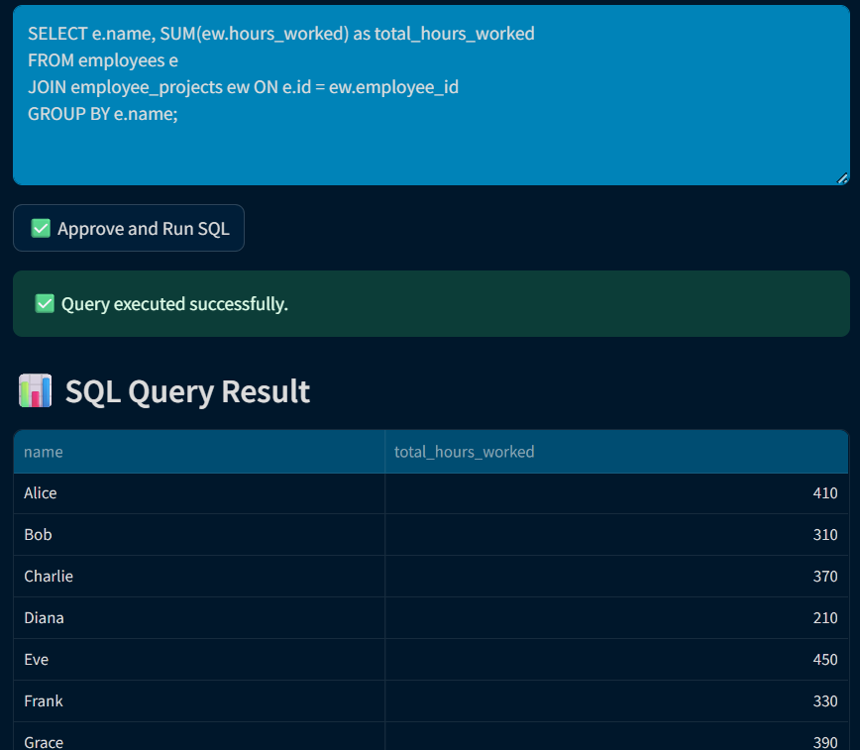
MVP 3 – Run SQL Query
*

Slide 9
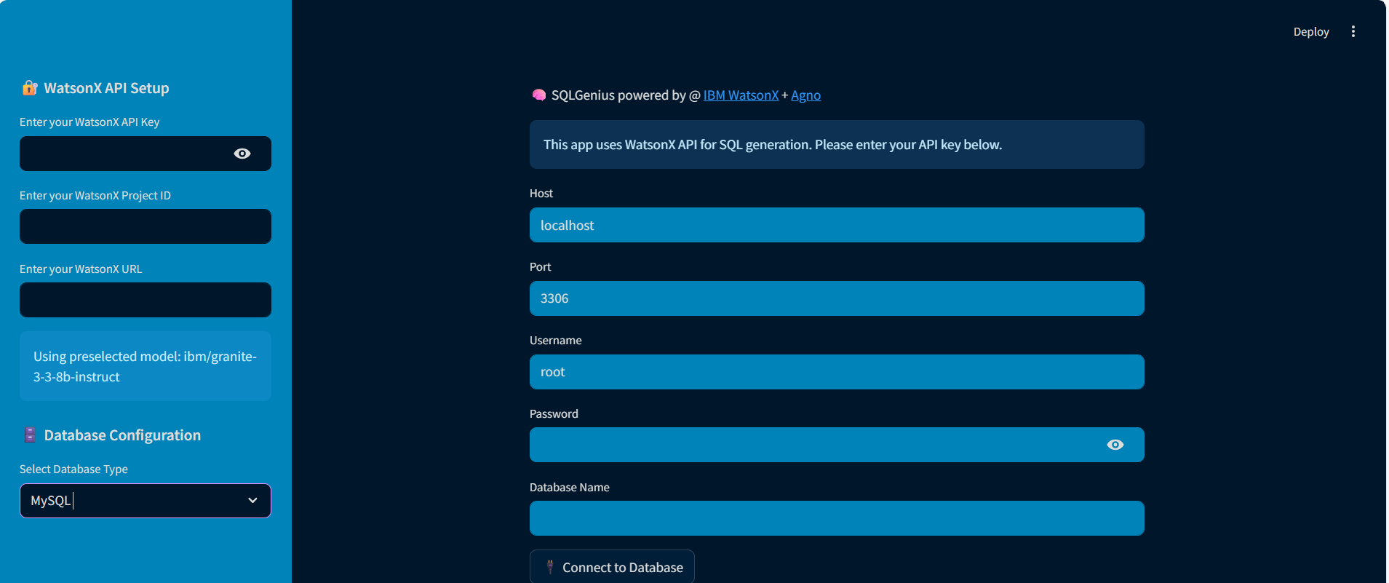
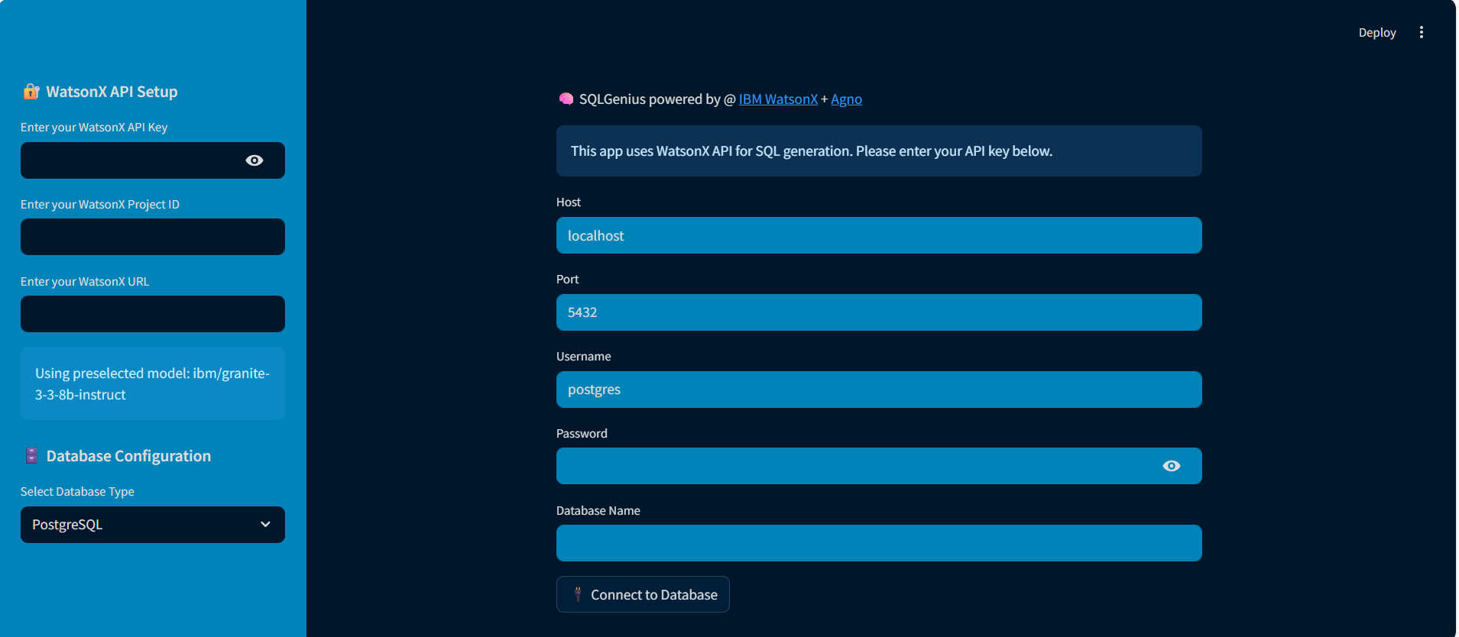
MVP 4 – MYSQL/POSTGRES DB Support
*

Slide 10
THANK YOU

